Slide 1
USB
BY ANSH KATIYAR
SECTION-A
ROLL N0. - 58
Bachelor of Computer Application
UEIT 4
C.S.J.M.U

Slide 2

The guy who invented the USB
AJAY V. BHATT

Slide 3
USB
UNIVERSAL SERIAL BUS
A mechanism used to connect peripheral devices to computers

Slide 4
THESE ARE TYPE OF USB
USB A
USB B
USB C
MICRO USB
MINI USB
USB 2.0
USB3.0
USB 3.1
USB 3.2
USB 4.0

Slide 5
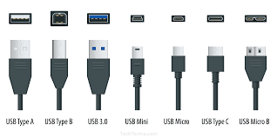
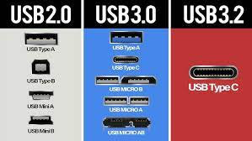

Slide 6
SPEED OF DATA TRANSFER
USB 1.0 12 Mbps
USB 2.0 UPTO 480Mbps
USB 3.0 UPTO 5 Gbps
USB 3.1 UPTO 10 Gbps
USB 3.2 UPTO 20Gbps
USB 4.0 UPTO 40Gbps

Slide 7
POWER SUPPLY
USB 1.0 0.5 WATT
USB 2.0 2.5 WATT
USB 3.0 4.5 WATT
USB 3.1 4.5 WATT
USB 3.2 UPTO 30 WATT
USB 4.0 UPTO 100WATT

Slide 8
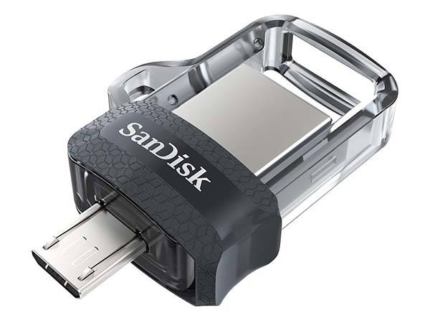
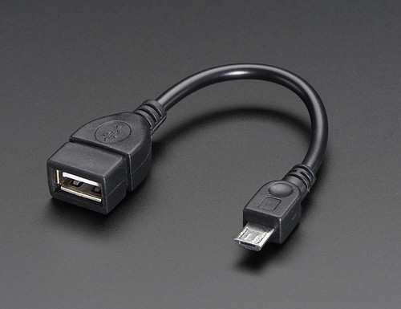
OTG
ON-THE-GO
OTG is a USB (Universal Serial Bus) standard that allows USB devices to be connected. Without using a computer connection, USB OTG items can connect.

Slide 9
VERSION OF USB
USB 1.0 15 JAN 1966
USB 2.0 27 APRIL 2000
USB 3.0 12 NOV 2008
USB 3.1 31 JULY 2013
USB 3.2 21 SEP 2017
USB 4.0 29 AUG 2019
MICRO USB 2007
OTG LAST IN 2001
USB TYPE C 12 AUG 2014

Slide 10
MINI USB ARE KNOWN AS USB2.0

Slide 11
THE ROLE OF USB
DATA TRANSFER
PERIPHERAL CONNECTION
CHARGING
POWER SUPPLY
DEVICE CONFIGURATION
HOT SWAPPING
AUDIO AND VIDEO
PERIPHERAL CHARGING
PERIPHERAL EXPANSION
DATA RECOVERY

Slide 12
LOOPHOLES OF USB 1.0
LOW DATA TRANSFER SPEED
LIMITED POWER DELIVERY
LIMITED DEVICE SUPPORT
COMPLEXITY OF DEVICE SUPPORT
LACK OF SCALABILITY
CONNECTOR DESIGE FLAWS
LIMITED COMPATIBILITY WITH MODERN DEVICE

Slide 13
LOOPHOLES OF USB 2.0
1. SPEED LIMITATION
2. SECURITY
3. COMPATIBILITY
4. LIMITED POWER DELIVERY
5. PHYSICAL VULNERABILITIES

Slide 14
LOOPHOLES OF USB 3.0
DATA LEAKAGE
MALWARE ON USE DRIVE
PHYSICAL ACCESS PROBLEM
FIRMWARE ATTACK

Slide 15
THANKS YOU

